Slide 1
ARN Monthly Meeting Liz Mover, RN-ARN- Blake 7 Christina Alexander, RN-ARN – Lunder 9 June 2, 2021

Slide 2
ARN Engagement Survey Results Summary
ARN Survey was conducted in February/March
39% ARN response rate
66% of ARNs reported that the monthly meeting was valuable
Majority of ARNs prefer to keep meeting on Wednesdays
#1 request was for more dialogue amongst the group about how the ARN role is implemented on various units
Prompted reaching out to the group with the following questions...

Slide 3
How many ARNs are on your unit?
1
2
3
4
5
7
Notes:
We will be attaching the updated ARN hospital directory to the e-mail with meeting minutes

Slide 4
How does scheduling work?
One ARN works every Monday. 3 other ARNs text to self-schedule the remaining days during timeplan.
Split the week; 2/3 days; not set days; self scheduled
Job share
Includes some shifts as bedside RN to make up weekly hour requirement
12 hour shifts
4 10 hour shifts- no coverage on other days
Scheduled as ARN per timeplan- 3 12hr shifts
One permanent ARN 3 days a week and rotating ARNs for other 2 days

Slide 5
Coverage 7 days a week?
Vast majority of ARNs reported Mon-Fri only
No weekend coverage
Resource RN takes over ARN responsibilities on weekend
sending out ARN DC email and meds/issues troubleshooting
Specialty unit with 7 days a week coverage
Weekend discharges can be challenging if proper prep was not done
Weekend outpatient pharmacy hours differ (closes 3pm Sat, 12:30pm Sun)
Very limited CM staffing on weekends
Simultaneous rounding structure requires additional person to run rounds

Slide 6
Combined ARN/Resource role?
No
Separate roles that work closely together
Yes
Notes:
Combined role if sick calls

Slide 7
What are your primary responsibilities?
Discharge huddle
Interdisciplinary rounds
Identify and overcome barriers to discharge
Resident MD education re: discharge
Staff/care team communication
Getting meds from Outpatient pharmacy
Complete HCP/Assist w/ and advocate for MOLST forms
Patient education
Assisting bedside RN
Managing beds
Nursing assignments
Projects/Committees

Slide 8
What are your primary responsibilities?
Arrange GOC meetings
Involve consulting services
Create rehab packets
Look ahead and work on barriers to discharge for coming days ahead
Checking on PAs
Ensuring follow up appts are made
Closing the loop amongst team members
Attending family meetings & documenting ACP notes
Assisting w/ family communication
Communicating w/ other ARNs to ensure smooth transition of pt across units
Take an assignment as needed
Complete discharge navigator paperwork

Slide 9
What type of education needs are most prevalent on your unit?
Diabetes, specifically insulin teaching
Heart failure
Diastat
G-tube
Safe sleep
Asthma
Anticoagulation
Clots/stents
Wound Care
Discharge/new medications
Trach care
Notes:
Blum Center made aware of our education needs and are compiling resources/future meeting presentations

Slide 10
Does ARN document in the patient chart? Or do you have a separate form of communication amongst your group if more than one ARN?
ARN Progress Notes
Getting to know me section
E-mail
Case by case basis
Direct verbal communication with team members
Sticky notes
Patient handoff (some units have dot phrase)
Care Coordination note
Advanced directives/GOC note=Advanced Care Planning
Microsoft Teams
Education tab in pt chart
Notes:
On Lunder 9 we have a dot phrase for handoff .L9ARN
Consults:
Primary Oncologist/NP:
HCP:
Dispo plan/barriers:
Growth factor:
Possible scripts/PAs needed:
F/u appt:

Slide 11
What is the most effective form of communication on your unit?
Huddles- most effective
Voalte messages- real time/time sensitive matters
E-mails
Staff meetings

Slide 12
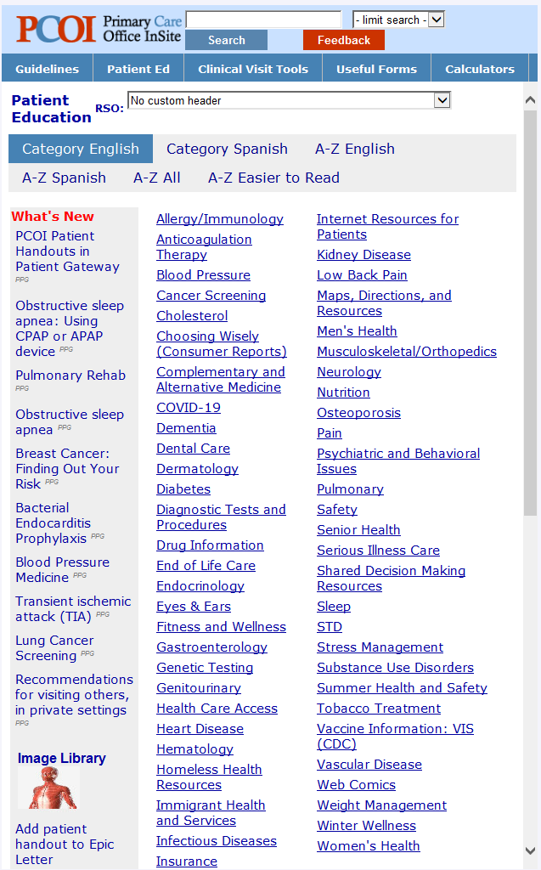
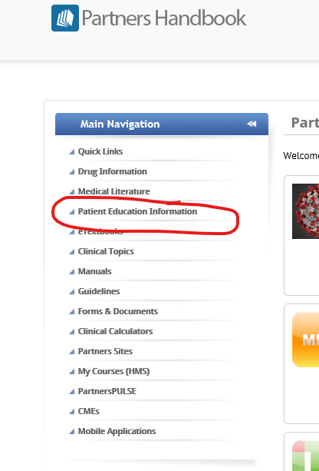
Patient Education Resources
Contact The Maxwell & Eleanor Blum Patient and Family Learning Center
Phone: 617-724-7352
E-mail: PFLC@partners.org
www.massgeneral.org/blum-center
Hours of operation: 9a-4:30p M-F

Slide 13
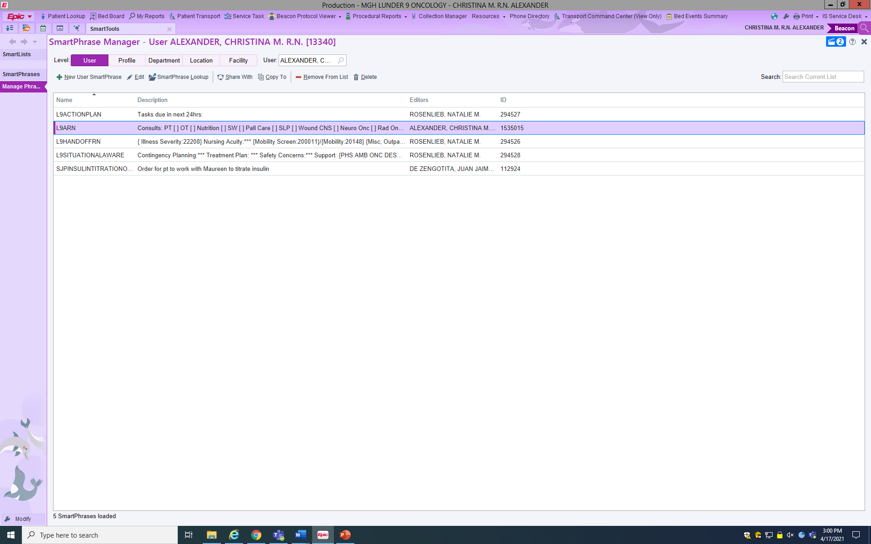
How to make a dot phrase

Slide 14
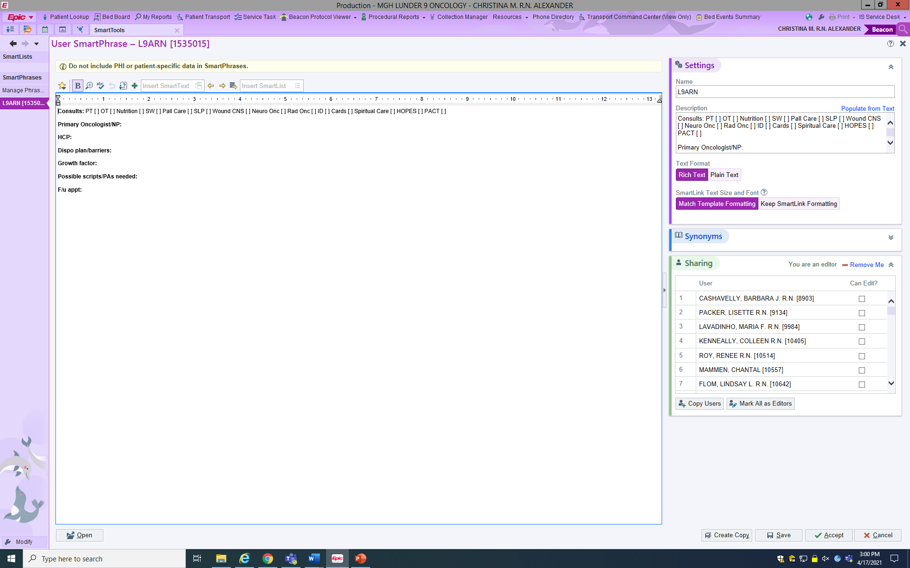
You need to manually add users in order for them to be able to use the dot phrase

